Slide 1
Balanced Dual CRLH Microstrip Line With Modified CSRRs
Zachary Silva

Slide 2
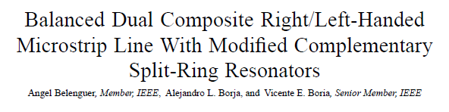
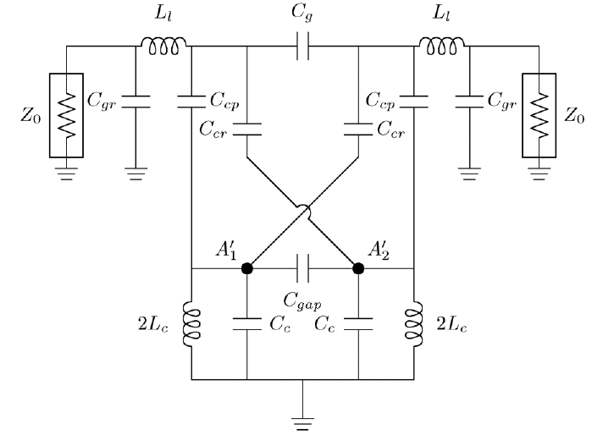
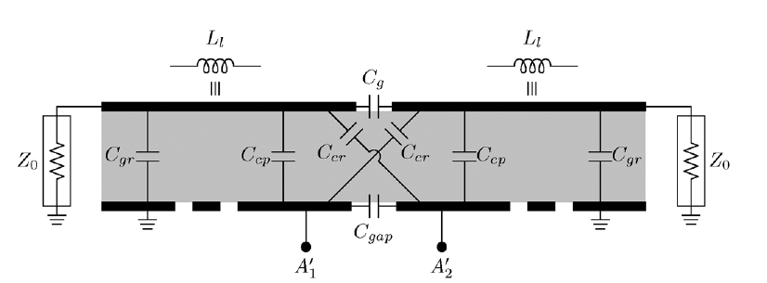
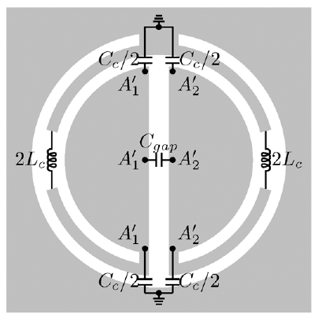
Equivalent Circuit from paper
Adapted from:
Notes:
Link to paper: http://ieeexplore.ieee.org/stamp/stamp.jsp?arnumber=6552999
“improved frequency response in terms of bandwidth and reconfigurability.”

Slide 3
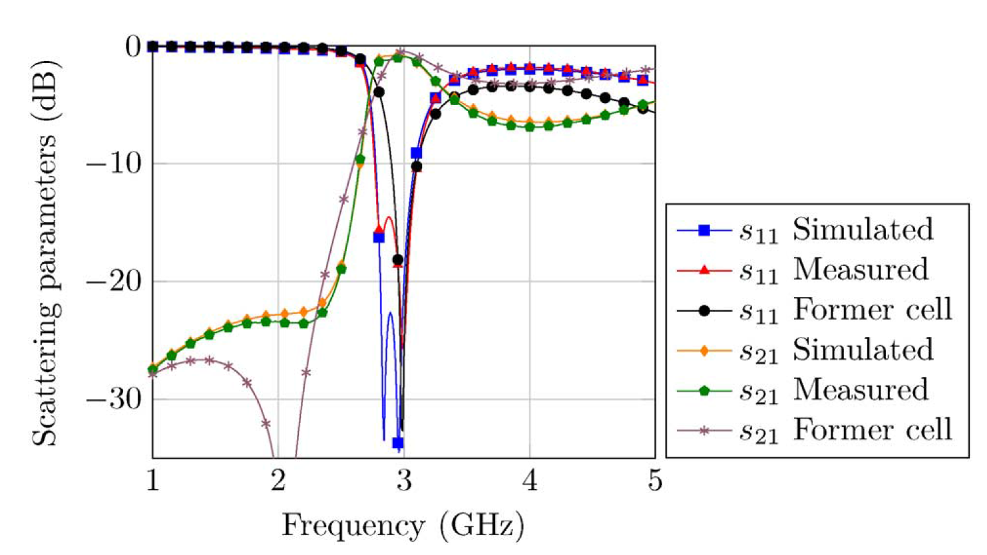
Results from text:
Notes:
S11 and S21 results from paper. Includes the simulated cell, simulated device, and measured device.

Slide 4
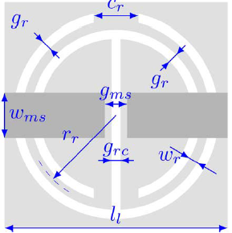
Parameters
 | Paper (mm) | Model (mm)
wms | 3.37 | 3.37
gms | 0.5 | 0.5
rr | 3.64 | 3.7
cr | 2 | 1
wr | 0.4 | 0.4
gr | 0.4 | 0.4
grc | 0.85 | 0.6
t | 1.524 | 1.524
dielectric | 3.55 | 2.55
Notes:
Adjusted some parameters to adapt what we had in the lab to match the papers results.

Slide 5
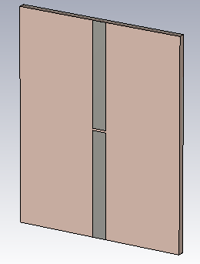
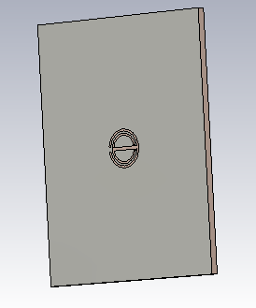

Simulated Model
Notes:
Left: Front– microstrip line Right: Back- Ground plane with modified CSRR

Slide 6
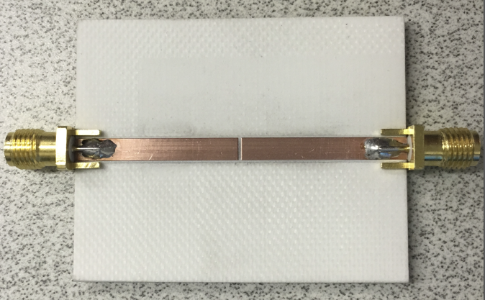
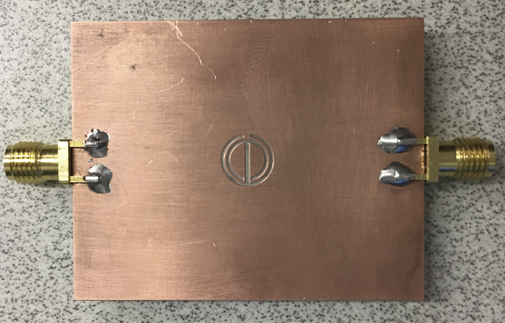
Fabricated Device
Top Microstrip
Ground Plane with Modified CSRR

Slide 7
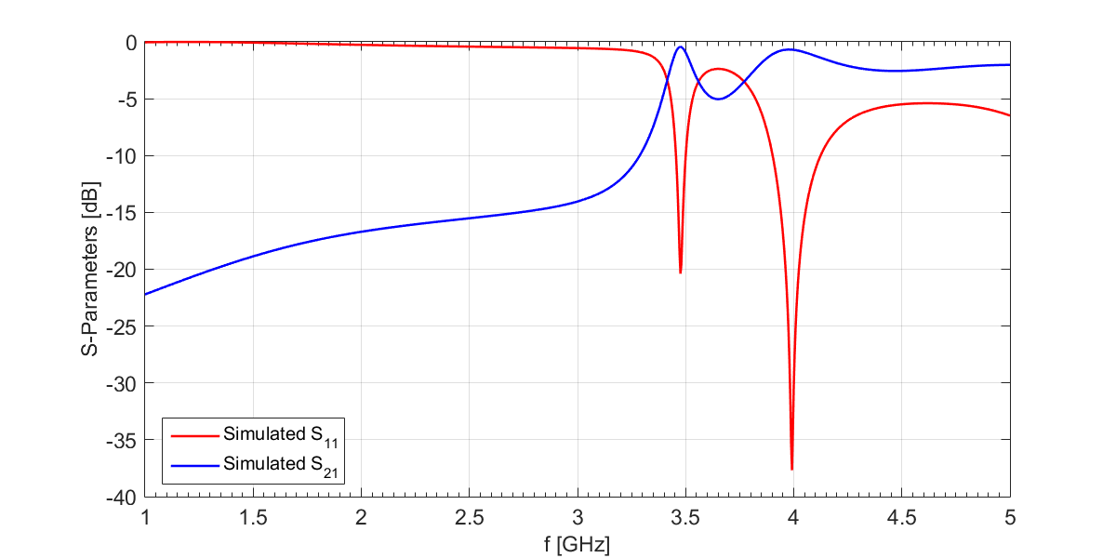
S-Parameters (Simulated)
Notes:
“A balanced dual CRLH microstrip line based on modified CSRRs with improved frequency response in terms of bandwidth and re-configurability.”
My results differ slightly from the papers measurements. I am operated at a higher frequency due to a dielectric of 2.55 instead of 3.55 and there are minor changes to the structure to obtain consistent results. My frequency bands where S11 is minimum are more spread out than in the paper causing about 5dB attenuation to occur between the two bands.

Slide 8
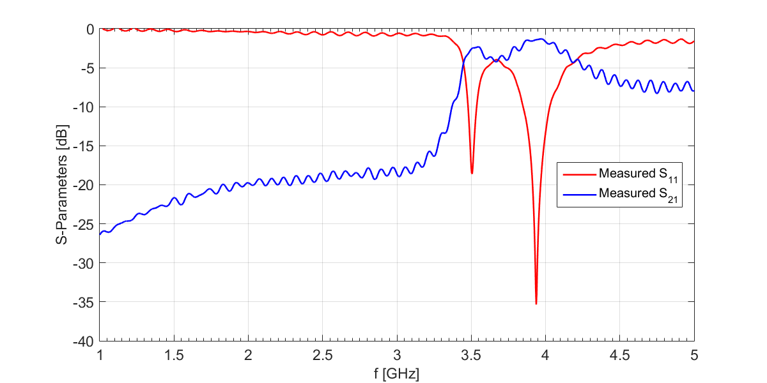
S-Parameters (Measured)
Notes:
Interesting behavior after 4GHz but overall worked as expected with minor differences. The operating frequencies were pretty much exactly as simulated. S21 is a little smaller than expected but the agreement between simulated and measured is relatively close.

Slide 9
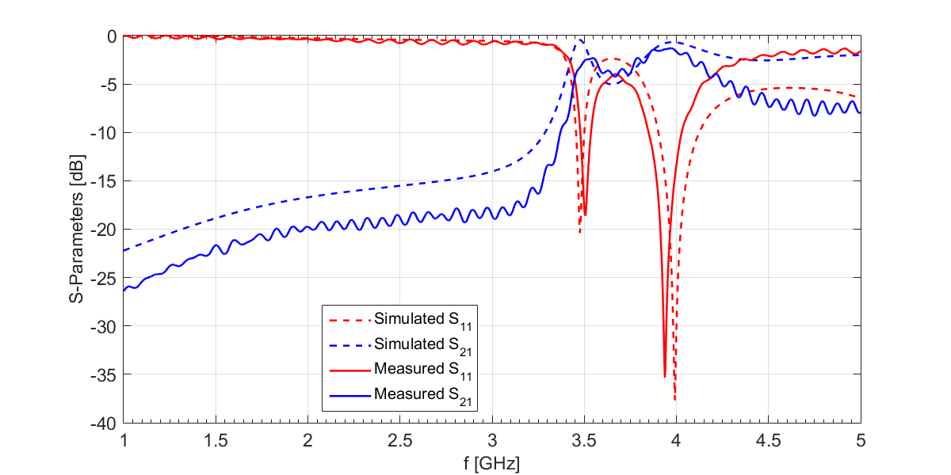
S-Parameters (Simulated & Measured)
Notes:
Agreement between simulated and measured.

Slide 10
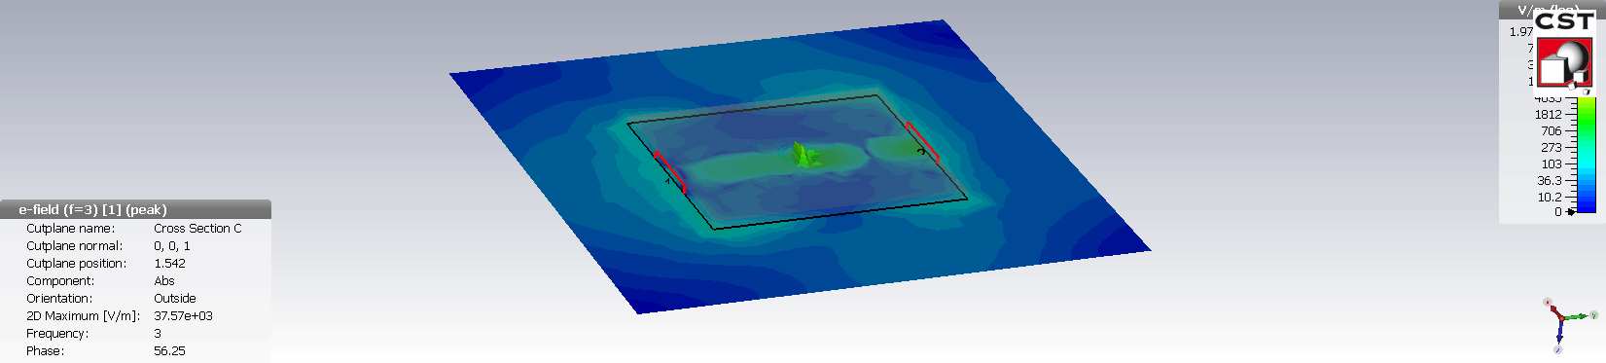
Carpet Plot [3GHz]
Notes:
No propagation

Slide 11
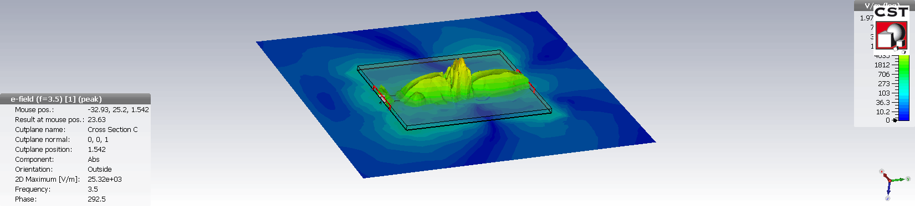
Carpet Plot [3.5GHz]
Notes:
Full propagation. First operating frequency.

Slide 12
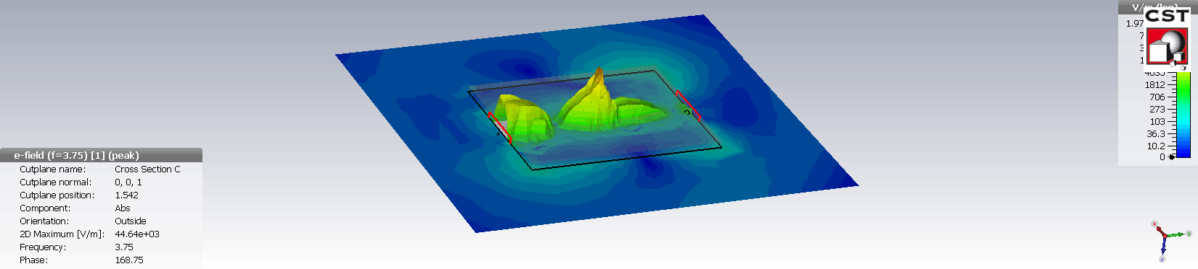
Carpet Plot [3.75GHz]
Notes:
Minor attenuation. Where the S21 dips between the two frequencies. Based on my measurements this is about how the device would operate.

Slide 13
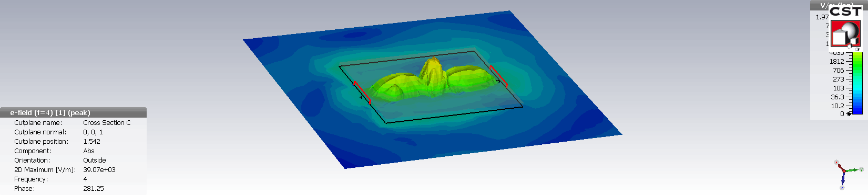
Carpet Plot [4GHz]
Notes:
Full propagation. Second operating frequency

